Slide 1
Solving Software Engineering Problems using Neural Networks
An Overview
Carol Alexandru
s.e.a.l. Softalk
21.01.2015

Slide 2
Motivation
Enormous corpus of source code online
How can we leverage this source code?
Notes:
LISA failed as an approach using „rule based“ programming

Slide 3
Motivation
Enormous corpus of source code online
How can we leverage this source code?
Can we create new programs from existing code?

Slide 4
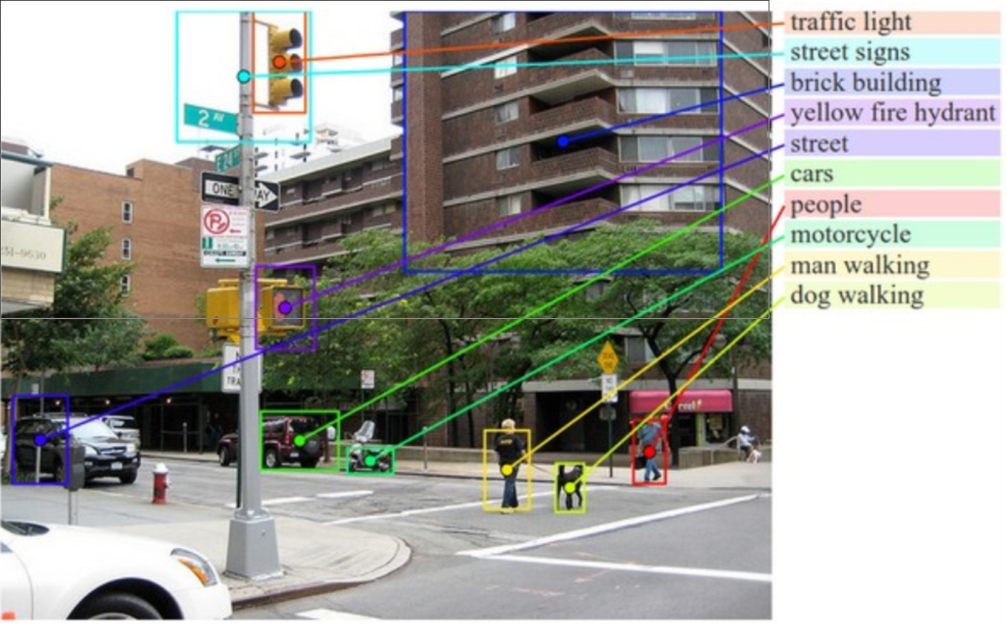
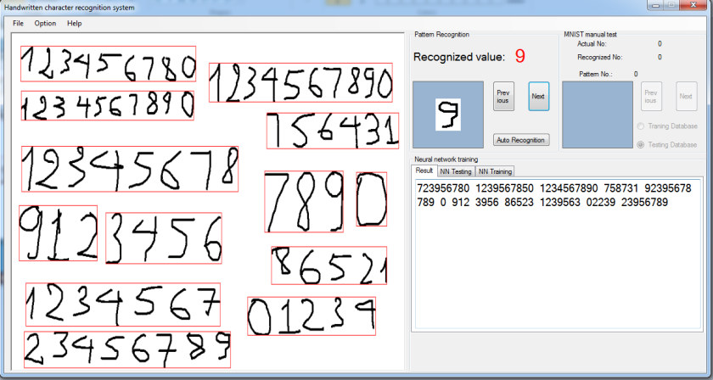
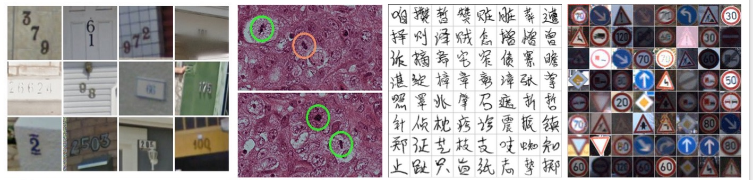
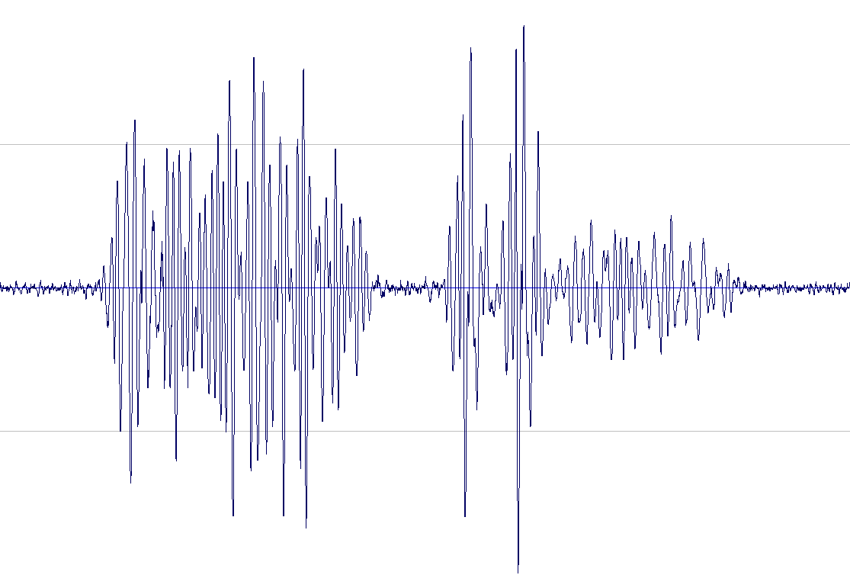
Neural Networks can recognize...

Slide 5
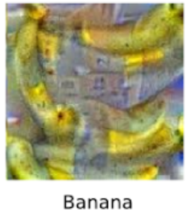
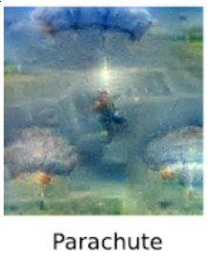
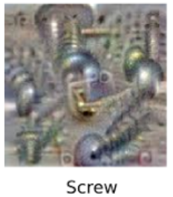
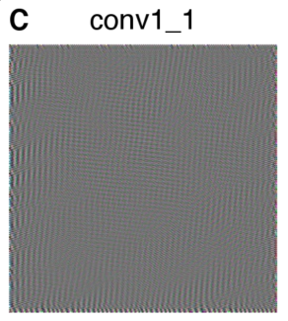
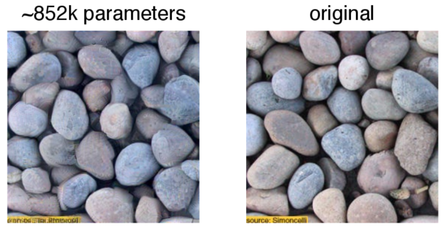
...but they can also synthesize!
Good everybody. Thank you very much. God bless the United States of America, and has already began with the world’s gathering their health insurance. It’s about hard-earned for our efforts that are not continued.
We are all the assumptionion to the streets of the Americas that we are still for everybody and destruction. We are doing a lot of this. I know that someone would be prefered to their children to take a million insurance company. We’re watching their people and continued to find ourselves with Republicans — to give up on these challenges and despite the challenges of our country. In the last two years, we must recognise that our borders have access from the world.

Slide 6
Outline
Part 1
Quick Intro to Artificial Neural Networks (ANN)
Part 2
Related Work applying ANN to SE Problems
Part 3
Current Work & Avenues for further research

Slide 7
Part 1
Quick Intro to Artificial Neural Networks (ANN)

Slide 8
Neural Networks
A type of machine learning
Around since the 1950s
Gained traction in the late 2000s thanks to higher availability of computational resources

Slide 9
Neural Networks
A type of machine learning
Around since the 1950s
Gained traction in the late 2000s thanks to higher availability of computational resources
Good at recognizing complex patterns and dependencies in raw data
„The“ solution for hard classification and recognition problems

Slide 10
Neural Networks - Overview
i1
h11
h21
i2
o1
h12
h22
i3
o2
h13
h23
i4

Slide 11
Neural Networks – Input Layer
Input layer
i1
h11
h21
i2
o1
h12
h22
i3
o2
h13
h23
i4
E.g.: pixels of an image
Stock market changes during a day
Symptoms of an ill patient
Source code tokens

Slide 12
Neural Networks - Hidden Layers
1 or more hidden layers
(more layers = „deep“ NN)
i1
h11
h21
i2
o1
h12
h22
i3
o2
h13
h23
i4
Semantically undetermined
(often reverse engineered)

Slide 13
Neural Networks - Hidden Layers
1 or more hidden layers
(more layers = „deep“ NN)
i1
h11
h21
i2
o1
h12
h22
i3
o2
h13
h23
i4
Semantically undetermined
(often reverse engineered)
static activation function,
e.g. sigmoid activation

Slide 14
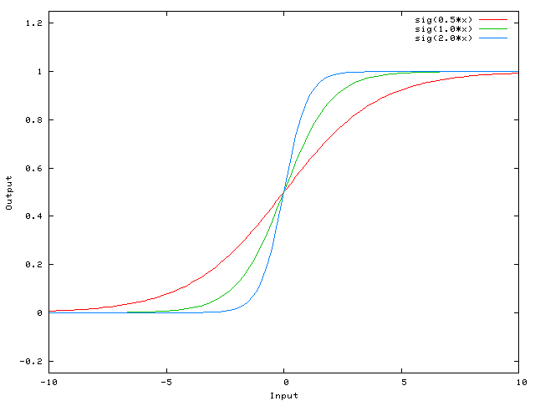
Neural Networks - Hidden Layers
1 or more hidden layers
(more layers = „deep“ NN)
i1
h11
h21
i2
o1
h12
h22
i3
o2
h13
h23
i4
Semantically undetermined
(often reverse engineered)
static activation function,
e.g. sigmoid activation

Slide 15
Neural Networks - Hidden Layers
1 or more hidden layers
(more layers = „deep“ NN)
i1
i2
o1
i3
o2
i4
Semantically undetermined
(often reverse engineered)
static activation function,
e.g. sigmoid activation

Slide 16
Neural Networks – Output Layer
Output layer
i1
i2
o1
i3
o2
i4
E.g.: Tags associated with an image
Changes in tomorrows stock market
Probable medical diagnoses
Tags associated with the source code

Slide 17
Neural Networks
i1
i2
o1
i3
o2
i4
Layers are fully connected
Each connections is weighted

Slide 18
Neural Networks
i1
i2
o1
i3
o2
This is what we train!
i4
Layers are fully connected
Each connections is weighted
(weights can be negative)

Slide 19
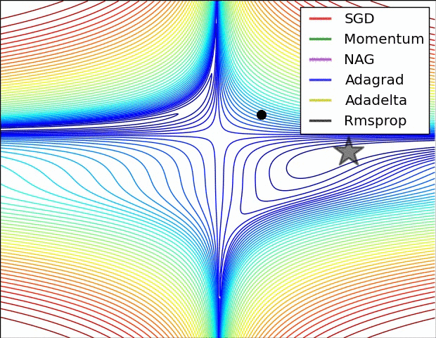
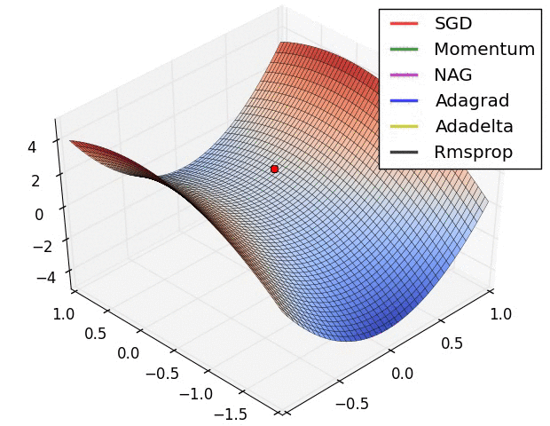
Neural Networks
i1
i2
o1
i3
o2
This is what we train!
i4
Layers are fully connected
Each connections is weighted
(weights can be negative)

Slide 20
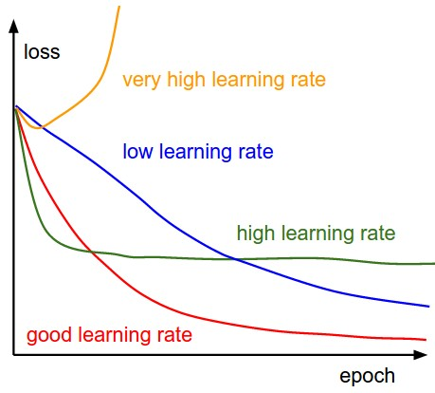
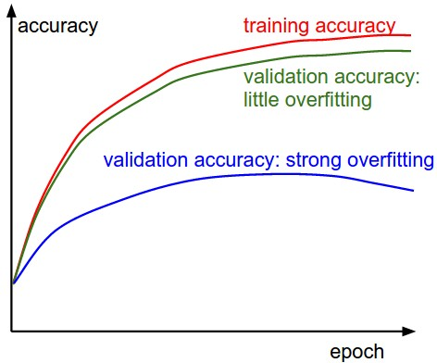
Neural Networks
i1
i2
o1
i3
o2
This is what we train!
i4
Layers are fully connected
Each connections is weighted
(weights can be negative)

Slide 21
Concrete Example: XOR
a | b | c
0 | 0 | 0
1 | 0 | 1
0 | 1 | 1
1 | 1 | 0
a
c
b
1
f =
0
0

Slide 22
Concrete Example: XOR
a | b | c
0 | 0 | 0
1 | 0 | 1
0 | 1 | 1
1 | 1 | 0
a
1
1
-1
c
-1
b
1
1
1
f =
0
An ANN would likely come up with different weights
0

Slide 23
Concrete Example: XOR input [0,0]
simplified
f(0*1+0*-1) = f(0) = 0
a | b | c
0 | 0 | 0
1 | 0 | 1
0 | 1 | 1
1 | 1 | 0
0
1
0
1
-1
0
-1
0
0
1
1
f(0*-1+0*1) = f(0) = 0
1
f =
0
0

Slide 24
Concrete Example: XOR input [1,0]
f(1*1+0*-1) = f(1) = 1
a | b | c
0 | 0 | 0
1 | 0 | 1
0 | 1 | 1
1 | 1 | 0
1
1
1
1
-1
1
-1
0
0
1
1
f(1*-1+0*1) = f(-1) = 0
1
f =
0
0

Slide 25
Concrete Example: XOR input [0,1]
f(0*1+1*-1) = f(-1) = 0
a | b | c
0 | 0 | 0
1 | 0 | 1
0 | 1 | 1
1 | 1 | 0
0
1
0
1
-1
1
-1
1
1
1
1
f(0*-1+1*1) = f(1) = 1
1
f =
0
0

Slide 26
Concrete Example: XOR input [1,1]
f(1*1+1*-1) = f(0) = 0
a | b | c
0 | 0 | 0
1 | 0 | 1
0 | 1 | 1
1 | 1 | 0
1
1
0
1
-1
0
-1
1
0
1
1
f(1*-1+1*1) = f(0) = 0
1
f =
0
0

Slide 27
Concrete Example: XOR
a | b | c
0 | 0 | 0
1 | 0 | 1
0 | 1 | 1
1 | 1 | 0
a
1
1
-1
c
-1
b
1
1
1
f =
0
0

Slide 28
Basic Neural Networks - Summary
Any number of inputs and outputs
Any number of hidden layers (even just 1)
Activation function (often sigmoid + bias)
Training happens on the weights of the links
There is no real „signaling“, the entire network can be represented as a single math function
Can be used for both regression and classification problems

Slide 29
Part 2
Related Work applying ANN to SE

Slide 30
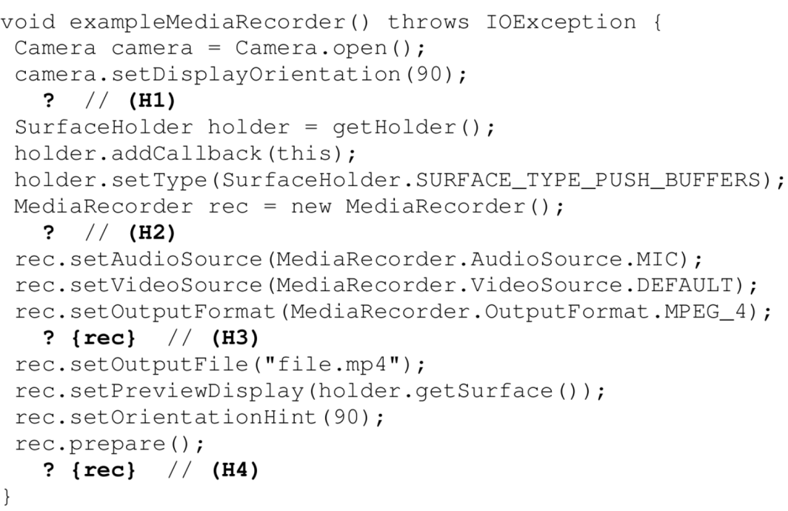
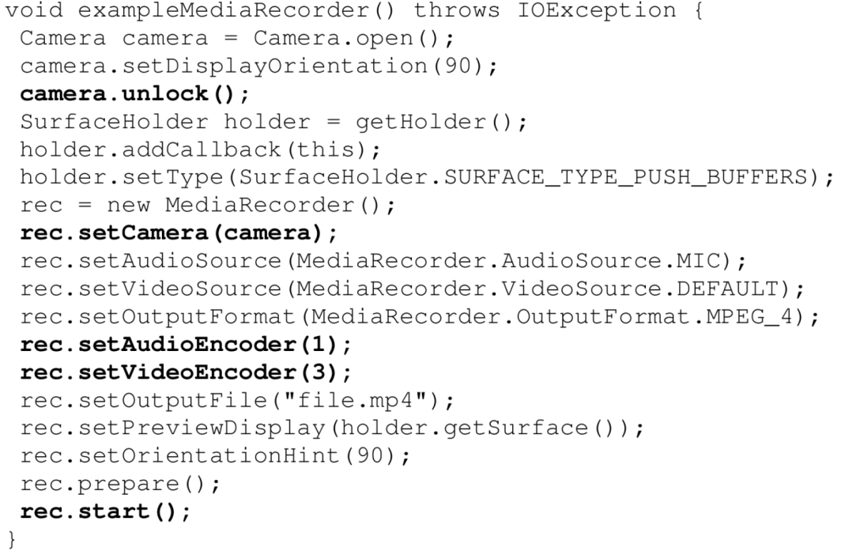
Software Reliability Lab (ETHZ)
SLANG (PLDI 14):
Code Completion (gap filling) using n-grams and ANN with regard to API usage

Slide 31
Software Reliability Lab (ETHZ)
JSNice (POPL 15):
Predicting variable names and inferring types in obfuscated JavaScript code using Conditional Random Fields (CRF)
Special kind of classifier that takes neighboring output nodes into account when making output predictions

Slide 32
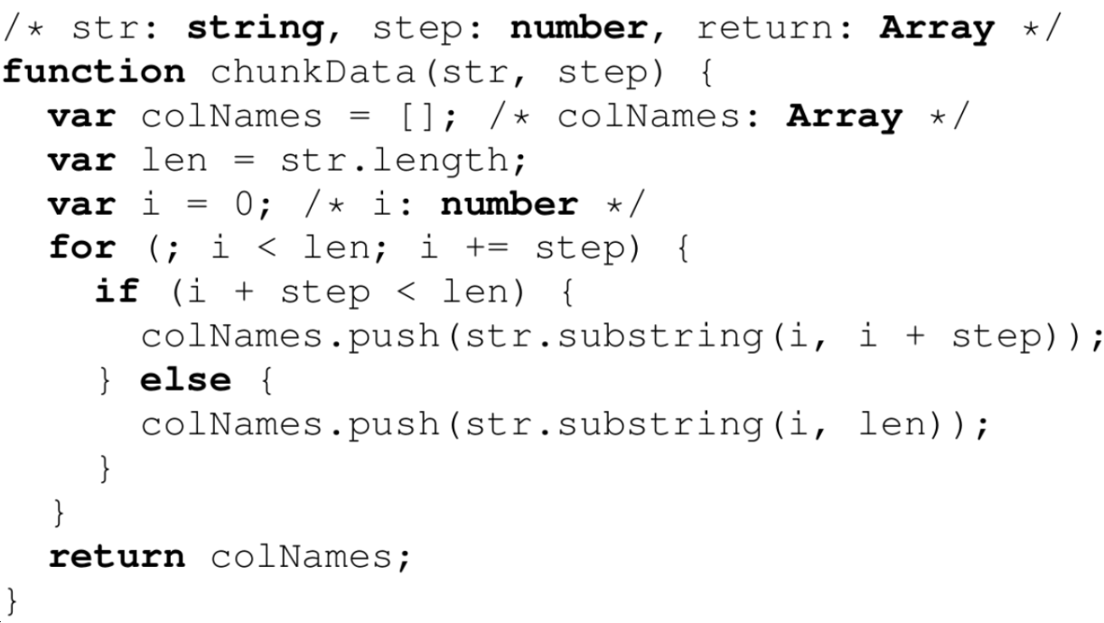
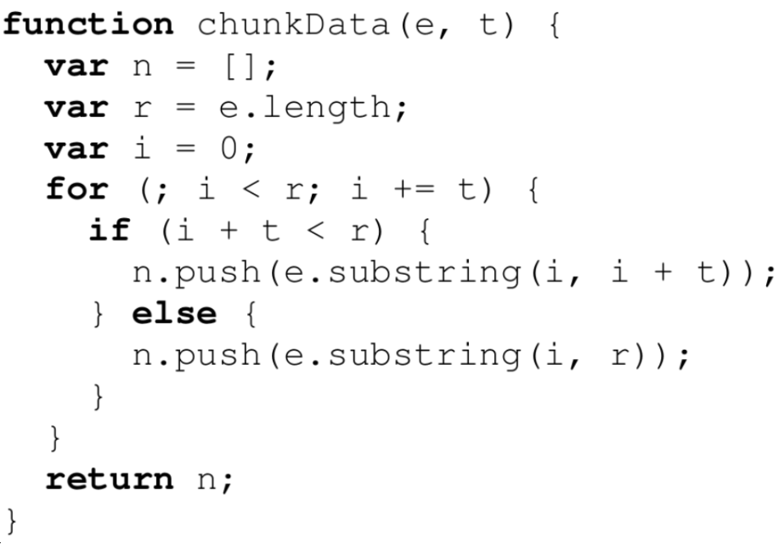
Software Reliability Lab (ETHZ)
JSNice (POPL 15):
Predicting variable names and inferring types in obfuscated JavaScript code using Conditional Random Fields (CRF)

Slide 33
Other Related Work
Arar et al.: “Software defect prediction using cost-sensitive neural network” (ASC 2015)
ANN + Artifical Beehive Colony algorithm, Similar performance to existing bug prediction approaches
Corley et al.: “Exploring the Use of Deep Learning for Feature Location” (ICSME15)
Preliminary Study using Latent Dirichlet Allocation (LDA) vs. Document Vectors (DV). DV are very fast - could be used for IDE-based search functionality
White et al.: „Toward Deep Learning Software Repositories“ (MSR15)
ANN better than n-gram model at predicting the next token (code suggestion)

Slide 34
Part 3
Current Work & Avenues for further research

Slide 35
Models vs. ANN

Slide 36
Models vs. ANN
Parsing
Compilation
Feature Extraction
Rule-Based Decision or ML
Results

Slide 37
Models vs. ANN
Tooling, hand-picked projects
Parsing
Compilation
Feature Extraction
Rule-Based Decision or ML
Results

Slide 38
Models vs. ANN
Tooling, hand-picked projects
Feature catalogue
Parsing
Compilation
Feature Extraction
Rule-Based Decision or ML
Results

Slide 39
Models vs. ANN
Tooling, hand-picked projects
Feature catalogue
Rule catalogue
Parsing
Compilation
Feature Extraction
Rule-Based Decision or ML
Results

Slide 40
Models vs. ANN
Tooling, hand-picked projects
Feature catalogue
Rule catalogue
Actionable results are elusive
Parsing
Compilation
Feature Extraction
Rule-Based Decision or ML
Results

Slide 41
Models vs. ANN
Tooling, hand-picked projects
Feature catalogue
Rule catalogue
Actionable results are elusive
Parsing
Compilation
Feature Extraction
Rule-Based Decision or ML
Results
e.g. SOFAS, LISA, FindBugs, ...

Slide 42
Models vs. ANN
Tooling, hand-picked projects
Feature catalogue
Rule catalogue
Actionable results are elusive
Parsing
Compilation
Feature Extraction
Rule-Based Decision or ML
Results
Plain Data + Outcomes
Machine Learning
Results
Reverse-Engineering of Features

Slide 43
Models vs. ANN
Tooling, hand-picked projects
Feature catalogue
Rule catalogue
Actionable results are elusive
Parsing
Compilation
Feature Extraction
Rule-Based Decision or ML
Results
Easier data collection
Plain Data + Outcomes
Machine Learning
Results
Reverse-Engineering of Features

Slide 44
Models vs. ANN
Tooling, hand-picked projects
Feature catalogue
Rule catalogue
Actionable results are elusive
Parsing
Compilation
Feature Extraction
Rule-Based Decision or ML
Results
Easier data collection
Plain Data + Outcomes
Machine Learning
Results
Reverse-Engineering of Features
Inputs & outcomes based in reality

Slide 45
Models vs. ANN
Tooling, hand-picked projects
Feature catalogue
Rule catalogue
Actionable results are elusive
Parsing
Compilation
Feature Extraction
Rule-Based Decision or ML
Results
Easier data collection
Resource intensive
Plain Data + Outcomes
Machine Learning
Results
Reverse-Engineering of Features
Inputs & outcomes based in reality

Slide 46
Models vs. ANN
Tooling, hand-picked projects
Feature catalogue
Rule catalogue
Actionable results are elusive
Parsing
Compilation
Feature Extraction
Rule-Based Decision or ML
Results
Easier data collection
Resource intensive
Suprisingly useful results
Plain Data + Outcomes
Machine Learning
Results
Reverse-Engineering of Features
Inputs & outcomes based in reality

Slide 47
Models vs. ANN
Tooling, hand-picked projects
Feature catalogue
Rule catalogue
Actionable results are elusive
Parsing
Compilation
Feature Extraction
Rule-Based Decision or ML
Results
Easier data collection
Resource intensive
Suprisingly useful results
ANN is a „black box“
Plain Data + Outcomes
Machine Learning
Results
Reverse-Engineering of Features
Inputs & outcomes based in reality

Slide 48
Models vs. ANN
Instead of trying to model the complexity of source code, let the machine figure out what matters to make useful predictions

Slide 49
First Steps...
Based on work by Andrej Karpathy (http://karpathy.github.io):
train an RNN to predict the next character
in a sequence of Java code

Slide 50
First Steps...
Based on work by Andrej Karpathy (http://karpathy.github.io):
train an RNN to predict the next character
in a sequence of Java code
Clone
693 Apache Projects

Slide 51
First Steps...
Based on work by Andrej Karpathy (http://karpathy.github.io):
train an RNN to predict the next character
in a sequence of Java code
Clone
693 Apache Projects
Filter
-not -regex '.*\.java'

Slide 52
First Steps...
Based on work by Andrej Karpathy (http://karpathy.github.io):
train an RNN to predict the next character
in a sequence of Java code
8 parallel jobs, ~15min
Clone
693 Apache Projects
Filter
-not -regex '.*\.java'

Slide 53
First Steps...
Based on work by Andrej Karpathy (http://karpathy.github.io):
train an RNN to predict the next character
in a sequence of Java code
8 parallel jobs, ~15min
Clone
693 Apache Projects
Filter
-not -regex '.*\.java'
Dump
-not -regex '.*[tT]ests?.*'

Slide 54
First Steps...
Based on work by Andrej Karpathy (http://karpathy.github.io):
train an RNN to predict the next character
in a sequence of Java code
8 parallel jobs, ~15min
Clone
693 Apache Projects
Filter
-not -regex '.*\.java'
Dump
-not -regex '.*[tT]ests?.*'
= 1.8 GB Java Code

Slide 55
First Steps...
Input file size | 1.8 GB
Characters | 1 860 428 381
rnn_size | 1500
# Parameters | 46 776 232
Compute time

Slide 56
First Steps...
Input file size | 1.8 GB
Characters | 1 860 428 381
rnn_size | 1500
# Parameters | 46 776 232
Compute time | 315 days

Slide 57
First Steps...
Input file size | 1.8 GB
Characters | 1 860 428 381
rnn_size | 1500
# Parameters | 46 776 232
Compute time | 315 days

Slide 58
First Steps...
Input file size | 1.8 GB
Characters | 1 860 428 381
rnn_size | 1500
# Parameters | 46 776 232
Compute time | 315 days
Input file size | 64 MB
Characters | 64 042 220
rnn_size | 1500
# Parameters | 46 776 232
Compute time | 60 days
Input file size | 24 MB
Characters | 24 014 894
rnn_size | 1024
# Parameters | 21 503 075
Compute time | 1.6 days
Input file size | 6.8 MB
Characters | 7 034 943
rnn_size | 580
# Parameters | 7 026 218
Compute time | 6.8 hours

Slide 59
First Steps...
RNN Training performed using
Torch (Lua Scientific Computing Framework)
Nvidia GeForce GTX 970 GPU
Torch supports CUDA
15x faster than using CPU (i7-3770)!
Input file size | 6.8 MB
Characters | 7 034 943
rnn_size | 580
# Parameters | 7 026 218
Compute time | 6.8 hours

Slide 60
demo

Slide 61
Next Steps
RNN:
Larger/Longer training (2 weeks)
Adapt Character-based RNN for AST tokens
Predict next n tokens instead of just one
Allow „backtracking“ and „cycling“ in the predictions (using different
Code completion using RNN has been evaluated but not demonstrated (I think...)
This is simply a feasible starting point

Slide 62
ANN solutions for SE problems
Code completion, deobfuscation, synthesis
Translation
Classification (concept/feature location)
Prediction (bugs, changes, effort)
Detection (memory leaks, antipatterns)

Slide 63
Concept/Feature location
Problem | Feature/Concept location is a hard problem in SE and encompasses many issues, e.g. finding relevant search results during code search, giving useful code suggestions, linking code to bugs/reviews and many more
Goal | Enrich and tag code snippets with relevant information.

Slide 64
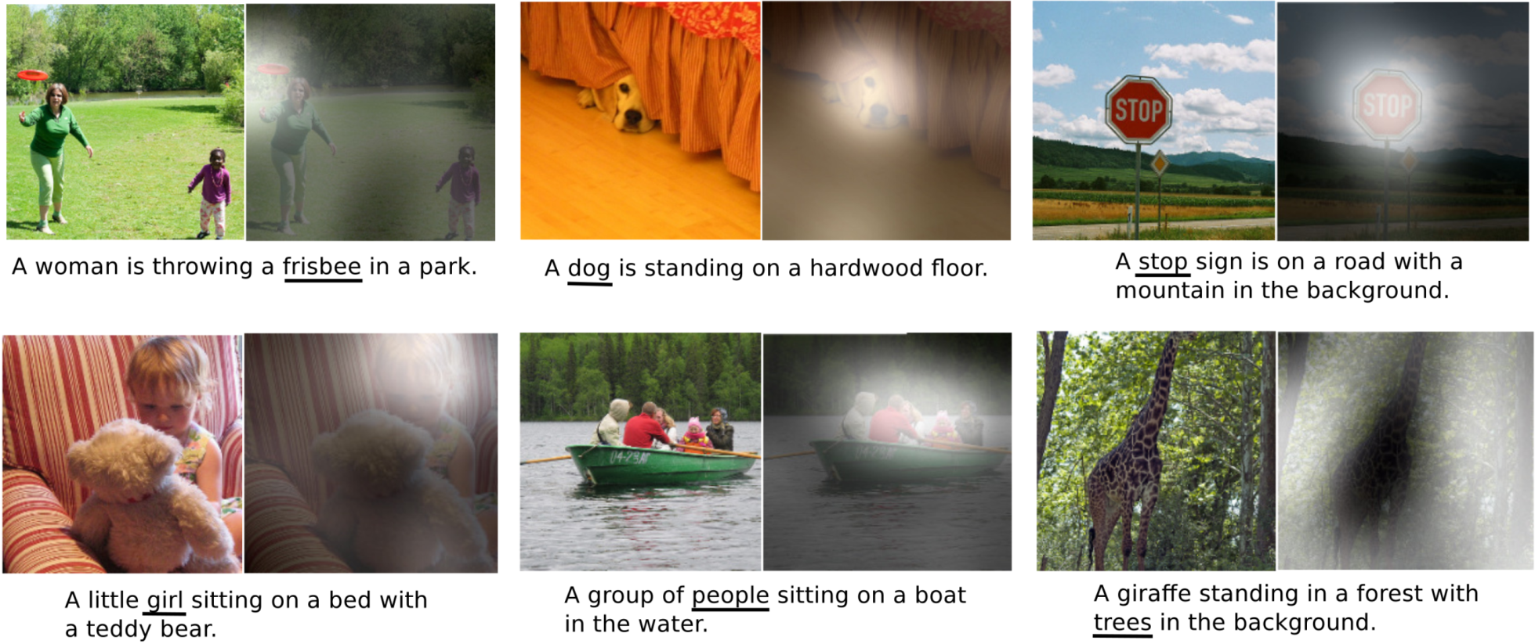
Directing „Attention“

Slide 65
Directing „Attention“
Teaching a NN to sequentially direct attention
Example: Reading house numbers left to right
For code: read code in order of execution/control flow?

Slide 66
Programming Language Translation
Java
Haskell

Slide 67
Programming Language Translation
Java
Haskell
Train on:
Rosetta Code
Project Euler Solutions
Multi-Platform Projects

Slide 68
Programming Language Translation
Java
Haskell
Train on:
Rosetta Code
Project Euler Solutions
Multi-Platform Projects
Use for:
Low-level Migration & Porting
Learning & Education
„Adaptive“ Rosetta Code

Slide 69
Programming Language Translation
Java
Haskell
Train on:
Rosetta Code
Project Euler Solutions
Multi-Platform Projects
Use for:
Low-level Migration & Porting
Learning & Education
„Adaptive“ Rosetta Code
Also consider:
Pseudo-Code ↔ Source Code
Natural Language ↔ Source Code

Slide 70
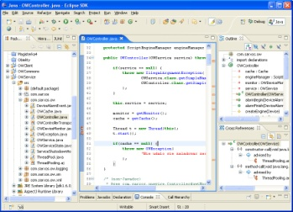
Guided Code Synthesis
Problem | When writing Code, developers frequently access SO, Google or other source code within the project, causing a large number of context switches
...

Slide 71
Guided Code Synthesis
Problem | When writing Code, developers frequently access SO, Google or other source code within the project, causing a large number of context switches
Goal | Keep the developer in the IDE. Use intent to steer the provided suggestions.
...

Slide 72
Guided Code Synthesis
import java.util.ArrayList;
public class Test {
main(
}

Slide 73
Guided Code Synthesis
import java.util.ArrayList;
public class Test {
main(public static void main(String[] args) {
}

Slide 74
Guided Code Synthesis
import java.util.ArrayList;
public class Test {
public static void main(String[] args) {
new list
}
}

Slide 75
Guided Code Synthesis
import java.util.ArrayList;
public class Test {
public static void main(String[] args) {
new listArrayList list = new ArrayList<>();
}
}

Slide 76
Guided Code Synthesis
import java.util.ArrayList;
public class Test {
public static void main(String[] args) {
new list stringArrayList<String> list = new ArrayList<>();
}
}

Slide 77
Guided Code Synthesis
import java.util.ArrayList;
public class Test {
public static void main(String[] args) {
ArrayList<String> list = new ArrayList<>();
}
}

Slide 78
Guided Code Synthesis
import java.util.ArrayList;
public class Test {
public static void main(String[] args) {
ArrayList<String> list = new ArrayList<>();
write CSV file
}
}

Slide 79
Guided Code Synthesis
import java.util.ArrayList;
public class Test {
public static void main(String[] args) {
ArrayList<String> list = new ArrayList<>();
write CSV fileCSVWriter writer = new CSVWriter(new FileWriter("file.csv"), '\t');
// feed in your array (or convert your data to an array)
String[] entries = "first#second#third".split("#");
writer.writeNext(entries);
writer.close();
}
}

Slide 80
Guided Code Synthesis
import java.util.ArrayList;
public class Test {
public static void main(String[] args) {
ArrayList<String> list = new ArrayList<>();
CSVWriter writer = new CSVWriter(new FileWriter("file.csv"), '\t');
// feed in your array (or convert your data to an array)
String[] entries = "first#second#third".split("#");
writer.writeNext(entries);
writer.close();
}
}

Slide 81
Guided Code Synthesis
import java.util.ArrayList;
public class Test {
public static void main(String[] args) {
ArrayList<String> list = new ArrayList<>();
CSVWriter writer = new CSVWriter(new FileWriter("file.csv"), '\t');
loop over argsfor (String s : args) {
}
writer.writeNext(entries);
writer.close();
}
}

Slide 82
Guided Code Synthesis
import java.util.ArrayList;
public class Test {
public static void main(String[] args) {
ArrayList<String> list = new ArrayList<>();
CSVWriter writer = new CSVWriter(new FileWriter("file.csv"), '\t');
loop over argsfor (String s : args) {
writer.writeNext(s);
}
writer.close();
}
}

Slide 83
Guided Code Synthesis
import java.util.ArrayList;
public class Test {
public static void main(String[] args) {
ArrayList<String> list = new ArrayList<>();
CSVWriter writer = new CSVWriter(new FileWriter("file.csv"), '\t');
for (String s : args) {
writer.writeNext(s);
}
writer.close();
}
}

Slide 84
Guided Code Synthesis
import java.util.ArrayList;
public class Test {
public static void main(String[] args) {
ArrayList<String> list = new ArrayList<>();
CSVWriter writer = new CSVWriter(new FileWriter("file.csv"), '\t');
for (String s : args) {
writer.writeNext(s);
}
writer.close();
}
}
Plain-Text Code Context
Code Suggestion
Island Parsing & Cleanup
Local Resolution & Navigation

Slide 85
Specifics of SE-Problems

Slide 86
Specifics of SE-Problems
Code is not just data (like an image) but a data transformer

Slide 87
Specifics of SE-Problems
Code is not just data (like an image) but a data transformer
We don‘t want to generate superfluous code

Slide 88
Specifics of SE-Problems
Code is not just data (like an image) but a data transformer
We don‘t want to generate superfluous code
Source code does not necessarily have a fixed „ordering“ in the data

Slide 89
Specifics of SE-Problems
Code is not just data (like an image) but a data transformer
We don‘t want to generate superfluous code
Source code does not necessarily have a fixed „ordering“ in the data
Source code is almost „noise free“ and highly structured (more than natural language)

Slide 90
Specifics of SE-Problems
Code is not just data (like an image) but a data transformer
We don‘t want to generate superfluous code
Source code does not necessarily have a fixed „ordering“ in the data
Source code is almost „noise free“ and highly structured (more than natural language)
Source code is richer (we can use parsers & compilers to enrich input data)

Slide 91
Specifics of SE-Problems
Code is not just data (like an image) but a data transformer
We don‘t want to generate superfluous code
Source code does not necessarily have a fixed „ordering“ in the data
Source code is almost „noise free“ and highly structured (more than natural language)
Source code is richer (we can use parsers & compilers to enrich input data)
We can automatically rate generated output

Slide 92
Open Questions
Killer use case? (Time savers!)
Code synthesis
Problem detection
Feature location
Data source?
source code
jar files / machine code
runtime data (memory, streams)

Slide 93
Summary

Slide 94
Thank you

Slide 96
Recurrent Neural Networks
Output does not only depend on given Input, but also on the entire history of inputs
E.g. Long Short-Term Memory (LSTM) Networks

Slide 97
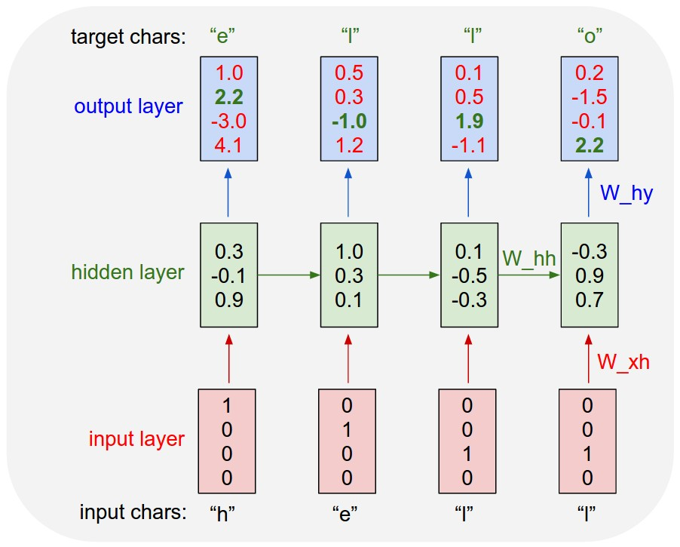
Recurrent Neural Networks
Output does not only depend on given Input, but also on the entire history of inputs
E.g. Long Short-Term Memory (LSTM) Networks

Slide 98
ANN work on numerical values
Classes:
[„dog“, „frog“,...]
[255,125,0]
i1
[188,110,4]
i2
o1
0.19491
[5,15,212]
i3
o2
0.95121
...
[125,25,25]
i4
...
...
o1 | [1,0,...]
o2 | [0,1,...]
... | ...
...

Slide 99
Guided Code Synthesis
Problem | When writing Code, developers frequently access SO, Google or other source code within the project, causing a large number of context switches
Goal | Keep the developer in the IDE by continously providing appropriate feedback and code suggestions. The developer should be able to input intent to steer the provided suggestions.
Approach | Use multi-layer recurrent networks that draw on multiple sources, i.e. user-provided code tokens, tags and task context. Use existing tool (Adapt) for translating user input to intent.

Slide 100
Concept tagging
Problem | Feature/Concept location is a hard problem in SE and encompasses many issues, e.g. finding relevant search results during code search, giving useful code suggestions, linking code to bugs/reviews and many more
Goal | Enrich and tag code snippets with relevant information.
Approach | Use convolutional recurrent networks and use attention steering to tag varying-size snippets in existing code.

Slide 101
Co-Change suggestions
Problem | Developers often need to change related code that is not connected explicitely (especially true in weak typed languages)
Goal | When the developer changes some code, suggest other locations and maybe even the required code
Approach | Pair-wise training on patches: Given one patch as input, expect another patch as output – either coarse (file and location within file) or fine (file, location and code suggestion). Take temporal distance into account (same commit == very close). Maybe include commit message in output.

Slide 102
„Neural Linter“
Problem | Linters & tools like findbugs are useful but often give too many results that are ignored. Also, different development teams have different priorities and coding styles.
Goal | Give only actionable, relevant and tailored information to developers
Approach | Train an ANN on existing data regarding proposed fixes and performed fixes to be used as a filter over new predictions. The system could learn over time for a single user as well.

Slide 103
Programming language translation
Problem | Upgrading legacy systems and writing the same code for different platforms can be difficult
Goal | Create template source code to serve as a starting point for manual translation
Approach | Use rosetta code problem solutions and multi-platform projects to train one model per language pair.
Existing? | Mostly rule based, i.e. compilers

Slide 104
Source Code from Pseudocode
Problem | Writing code is time consuming and difficult
Goal | Create valid source code from pseudo code definitions
Approach | Create a corpus of pseudo code to source code translations and train an ANN in order to create new translations
Existing? | Again, mostly rule-based with many restriction on the input syntax

Slide 105
Source Code from natural language
Problem | Writing code is time consuming and difficult
Goal | Create valid source code from human natural language.
Approach | Add a speech recognition tool to guided code synthesis.

Slide 106
Guided Code Synthesis
import java.util.ArrayList;
public class Test {
main(
}
User inputs:
main(

Slide 107
Guided Code Synthesis
import java.util.ArrayList;
public class Test {
main(public static void main(String[] args) {
}
User inputs:
main(

Slide 108
Guided Code Synthesis
import java.util.ArrayList;
public class Test {
public static void main(String[] args) {
new list
}
}
User inputs:
main(<TAB>
new list

Slide 109
Guided Code Synthesis
import java.util.ArrayList;
public class Test {
public static void main(String[] args) {
new listArrayList list = new ArrayList<>();
}
}
User inputs:
main(<TAB>
new list

Slide 110
Guided Code Synthesis
import java.util.ArrayList;
public class Test {
public static void main(String[] args) {
new list stringArrayList<String> list = new ArrayList<>();
}
}
User inputs:
main(<TAB>
new list string

Slide 111
Guided Code Synthesis
import java.util.ArrayList;
public class Test {
public static void main(String[] args) {
ArrayList<String> list = new ArrayList<>();
}
}
User inputs:
main(<TAB>
new list string<TAB>

Slide 112
Guided Code Synthesis
import java.util.ArrayList;
public class Test {
public static void main(String[] args) {
ArrayList<String> list = new ArrayList<>();
write CSV file
}
}
User inputs:
main(<TAB>
new list string<TAB>
write CSV file

Slide 113
Guided Code Synthesis
import java.util.ArrayList;
public class Test {
public static void main(String[] args) {
ArrayList<String> list = new ArrayList<>();
write CSV fileCSVWriter writer = new CSVWriter(new FileWriter("file.csv"), '\t');
// feed in your array (or convert your data to an array)
String[] entries = "first#second#third".split("#");
writer.writeNext(entries);
writer.close();
}
}
User inputs:
main(<TAB>
new list string<TAB>
write CSV file

Slide 114
Guided Code Synthesis
import java.util.ArrayList;
public class Test {
public static void main(String[] args) {
ArrayList<String> list = new ArrayList<>();
CSVWriter writer = new CSVWriter(new FileWriter("file.csv"), '\t');
// feed in your array (or convert your data to an array)
String[] entries = "first#second#third".split("#");
writer.writeNext(entries);
writer.close();
}
}
User inputs:
main(<TAB>
new list string<TAB>
write CSV file<TAB>

Slide 115
Guided Code Synthesis
import java.util.ArrayList;
public class Test {
public static void main(String[] args) {
ArrayList<String> list = new ArrayList<>();
CSVWriter writer = new CSVWriter(new FileWriter("file.csv"), '\t');
writer.writeNext(entries);
writer.close();
}
}
User inputs:
main(<TAB>
new list string<TAB>
write CSV file<TAB>
SHIFT-ALT-D-J-2

Slide 116
Guided Code Synthesis
import java.util.ArrayList;
public class Test {
public static void main(String[] args) {
ArrayList<String> list = new ArrayList<>();
CSVWriter writer = new CSVWriter(new FileWriter("file.csv"), '\t');
loop over argsfor (String s : args) {
}
writer.writeNext(entries);
writer.close();
}
}
User inputs:
main(<TAB>
new list string<TAB>
write CSV file<TAB>
SHIFT-ALT-D-J-2
loop over args

Slide 117
Guided Code Synthesis
import java.util.ArrayList;
public class Test {
public static void main(String[] args) {
ArrayList<String> list = new ArrayList<>();
CSVWriter writer = new CSVWriter(new FileWriter("file.csv"), '\t');
loop over argsfor (String s : args) {
writer.writeNext(s);
writer.close();
}
}
}
User inputs:
main(<TAB>
new list string<TAB>
write CSV file<TAB>
SHIFT-ALT-D-J-2
loop over args<SHIFT-M-I-2>

Slide 118
Guided Code Synthesis
import java.util.ArrayList;
public class Test {
public static void main(String[] args) {
ArrayList<String> list = new ArrayList<>();
CSVWriter writer = new CSVWriter(new FileWriter("file.csv"), '\t');
for (String s : args) {
writer.writeNext(s);
writer.close();
}
}
}
User inputs:
main(<TAB>
new list string<TAB>
write CSV file<TAB>
SHIFT-ALT-D-J-2
loop over args<SHIFT-M-I-2><TAB>

